Slide 1
INTELLIGENT TALENT SCOUTING MODEL FOR PREDICTING INDIVIDUAL PLAYER PERFORMANCE IN CRICKET USING MACHINE LEARNING AND DJANGO FRAMEWORK

Slide 2
Abstract:
In modern sports, especially cricket, identifying high-potential players early is critical to developing winning teams and optimizing performance outcomes. Traditional scouting methods, which often rely on subjective judgment and manual observation, can be inconsistent and time-consuming. To address these limitations, this project introduces an intelligent talent scouting system designed to predict individual player performance using advanced machine learning and deep learning techniques.The system leverages a wide range of historical and statistical data, such as batting ,bowling records and player profiles. By analyzing these variables, the model generates predictive insights that help assess a player's future performance potential. This data-driven approach offers enhanced accuracy and consistency in player evaluation, supporting more informed selection and development decisions.To make the system accessible and practical for stakeholders like team selectors, coaches, and analysts, a web-based application has been developed using the Django framework. The application provides a clean and interactive interface where users can input or upload player data and receive performance predictions along with visual feedback. It also maintains a database of analyzed players, enabling historical tracking and comparison. By integrating artificial intelligence with sports analytics, it opens up new possibilities for strategic planning and long-term player development, ultimately contributing to the advancement of cricket management.

Slide 3
EXISTING SYSTEM
Data visualization has the power to revolutionize sports. For example, the rise of shot maps has changed basketball strategy by visually illustrating where “good/bad” shots are taken from. As a result, professional basketball teams today take shots from very different positions on the court than they did 20 years ago. Although the shot map has transformed many facets of the game, there is still much room for improvement to support richer and more complex analytical tasks. More specifically, we believe that the lack of sufficient interactivity to support various analytical queries and the inability to visually compare differences across situations are significant limitations of current shot maps. To address these limitations and showcase new possibilities, we designed and developed HoopInSight, an interactive visualization system that centers around a novel spatial comparison visual technique, enhancing the capabilities of shot maps in basketball analytics. This article presents the system, with a focus on our proposed visual technique and its accompanying interactions, all designed to promote comparison of two different scenarios. Furthermore, we provide reflections on and a discussion of relevant issues, including considerations for designing spatial comparison techniques, the scalability and transferability of this approach, and the benefits and pitfalls of designing as domain experts.

Slide 4
Drawbacks:
The current shot maps do not effectively support visual comparison across different scenarios, limiting their utility in detailed analysis.
The existing system relies on relatively static visual techniques, which may not fully capture the dynamic aspects of basketball gameplay.
The system's design may not be fully optimized for usability and accessibility by non-experts, potentially limiting its broader adoption and effectiveness.

Slide 5
PROPOSED SYSTEM
The proposed system is an intelligent talent scouting platform designed to predict individual player performance in cricket by leveraging machine learning techniques. It focuses on transforming traditional scouting methods into a more objective, accurate, and efficient process. The system collects and analyzes various features such as batting and bowling statistics, fielding data, match conditions, and player profiles to assess a player’s potential. At the core of the system, the Random Forest algorithm is employed due to its high accuracy and ability to handle diverse and complex data effectively. This predictive model is integrated into a web application built using the Django framework, allowing users to input or upload player data, view prediction outcomes, and access insightful performance reports through a user-friendly interface. The platform also includes a backend database to manage player records and historical predictions, enabling selectors, analysts, and coaches to monitor talent progression and make data-driven decisions with greater confidence.

Slide 6
Advantages:
We build a different kind of sport shot recognition & different sports activities.
We build a production level application for deployment purpose.
We build a manual architecture for training purpose.
We recommend a proper training for each sport shots.
Employs rigorous performance evaluation metrics such as accuracy, precision, recall, F1-score, and confusion matrices, ensuring high reliability and validity of the results.

Slide 7
Objectives:
Develop deep learning models for accurate real-time classification of various sports shots, ensuring adaptability across sports and robustness to environmental factors.

Slide 8
Scope:
Includes diverse dataset collection, preprocessing, model selection, real-time implementation, and thorough testing for deployment in sports analysis, live broadcasting, and coaching applications.

Slide 9
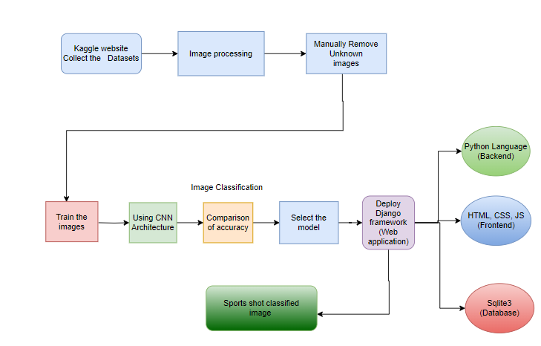
System Architecture

Slide 10
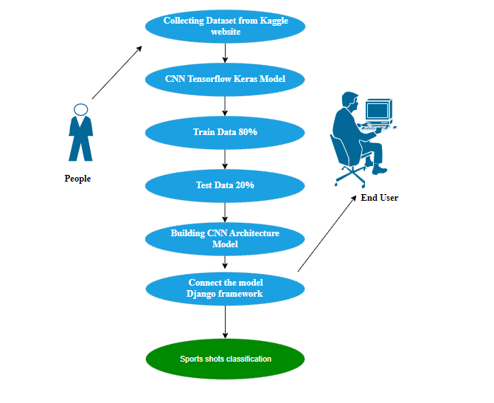
Usecase Diagram:

Slide 11
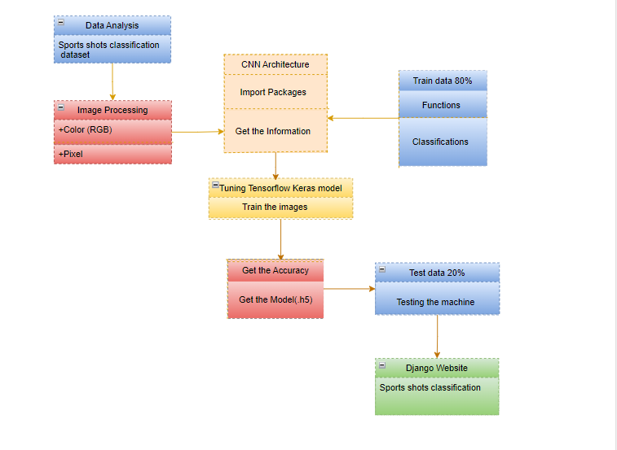
Class Diagram:

Slide 12
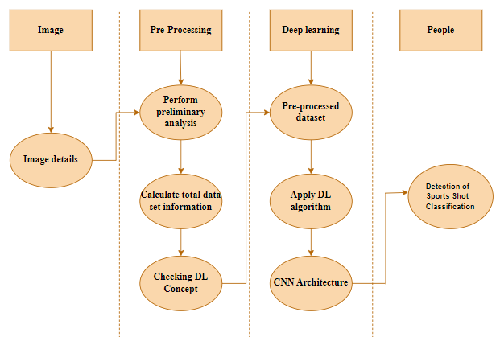
Sequence Diagram:

Slide 13
Environment Requirement:
1. Software Requirements:
Operating System : Windows / Linux
Simulation Tool : Anaconda with Jupyter Notebook
2. Hardware requirements:
Processor : Pentium IV/III
Hard disk : minimum 80 GB
RAM : minimum 2 GB

Slide 14
List Of Modules:
1. Manual Net
2. VGG
3. ALEXNET
4. LENET
5. Deploy

Slide 15
VGG:
VGG-Net Architecture
Let’s quickly examine VGG’s architecture:
Inputs: The VGGNet accepts 224224-pixel images as input. To maintain a consistent input size for the ImageNet competition, the model’s developers chopped out the central 224224 patches in each image.
Convolutional Layers: VGG’s convolutional layers use the smallest feasible receptive field, or 33, to record left-to-right and up-to-down movement. Additionally, 11 convolution filters are used to transform the input linearly. The next component is a ReLU unit, a significant advancement from AlexNet that shortens training time. Rectified linear unit activation function, or ReLU, is a piecewise linear function that, if the input is positive, outputs the input; otherwise, the output is zero. The convolution stride is fixed at 1 pixel to keep the spatial resolution preserved after convolution (stride is the number of pixel shifts over the input matrix).
Hidden Layers: The VGG network’s hidden layers all make use of ReLU. Local Response Normalization (LRN) is typically not used with VGG as it increases memory usage and training time. Furthermore, it doesn’t increase overall accuracy.
Fully Connected Layers: The VGGNet contains three layers with full connectivity. The first two levels each have 4096 channels, while the third layer has 1000 channels with one channel for each class.

Slide 16
ALEXNET:
AlexNet is a deep convolutional neural network architecture that gained significant attention and played a pivotal role in advancing the field of deep learning and computer vision. It was developed by Alex Krizhevsky, Ilya Sutskever, and Geoffrey Hinton, and won the 2012 ImageNet Large Scale Visual Recognition Challenge (ILSVRC).
Here's an overview of the architecture of AlexNet:
Input Layer: The network takes a color image as input. AlexNet was designed for images with a resolution of 224x224 pixels and three color channels (RGB).
Convolutional Layers: AlexNet contains five convolutional layers, each followed by a max-pooling layer. These layers are responsible for learning and extracting various features from the input image.
The first convolutional layer has 96 kernels of size 11x11 with a stride of 4.
The second and third convolutional layers have 256 and 384 kernels of size 5x5, respectively.
The fourth and fifth convolutional layers have 384 and 256 kernels of size 3x3, respectively.
Max-Pooling Layers: Max-pooling is applied after each of the first two convolutional layers. It helps reduce the spatial dimensions and keep the most important features.
Normalization Layers: Local response normalization is applied after the first and second convolutional layers. This helps with generalization.
Fully Connected Layers: After the convolutional and pooling layers, there are three fully connected layers. These layers are traditional feedforward neural network layers.
The first fully connected layer has 4096 neurons.
The second fully connected layer also has 4096 neurons.
The third fully connected layer has 1000 neurons, which corresponds to the number of classes in the ImageNet dataset (the original purpose of AlexNet).
Output Layer: The output layer has 1000 neurons, each representing a class in the ImageNet dataset. It uses a softmax activation function to compute the class probabilities.
Dropout: Dropout is applied to the two fully connected layers to prevent overfitting.
Activation Function: ReLU (Rectified Linear Unit) is used as the activation function in all layers except the output layer, which uses softmax.
Other Techniques: AlexNet made use of data augmentation, GPU acceleration, and multiple GPUs for training, which were novel at the time and contributed to its success.

Slide 17
LENET:
LeNet is a convolutional neural network that Yann LeCun introduced in 1989. LeNet is a common term for LeNet-5, a simple convolutional neural network.
The LeNet-5 signifies CNN’s emergence and outlines its core components. However, it was not popular at the time due to a lack of hardware, especially GPU (Graphics Process Unit, a specialised electronic circuit designed to change memory to accelerate the creation of images during a buffer intended for output to a show device) and alternative algorithms, like SVM, which could perform effects similar to or even better than those of the LeNet.
Features of LeNet-5
Every convolutional layer includes three parts: convolution, pooling, and nonlinear activation functions
Using convolution to extract spatial features (Convolution was called receptive fields originally)
The average pooling layer is used for subsampling.
‘tanh’ is used as the activation function
Using Multi-Layered Perceptron or Fully Connected Layers as the last classifier
The sparse connection between layers reduces the complexity of computation
Architecture
The LeNet-5 CNN architecture has seven layers. Three convolutional layers, two subsampling layers, and two fully linked layers make up the layer composition.

Slide 18
DEPLOY
Deploying the model in Django Framework and predicting output
In this module the trained deep learning model is converted into hierarchical data format file (.h5 file) which is then deployed in our django framework for providing better user interface and predicting the output whether the given material image is output

Slide 19
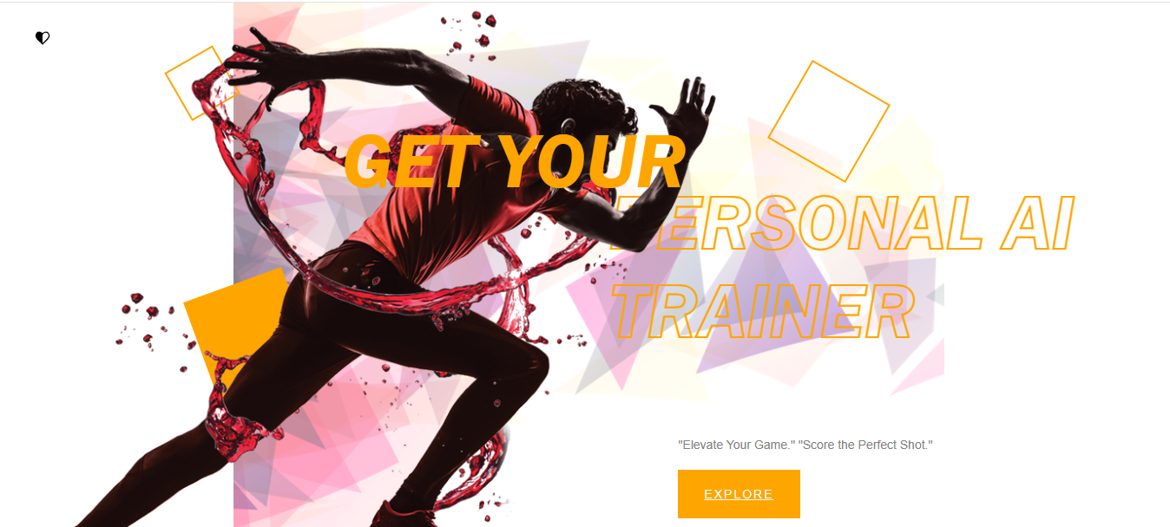
OUTPUT SCREENSHOT:

Slide 20

OUTPUT SCREENSHOT:

Slide 21

OUTPUT SCREENSHOT:

Slide 22
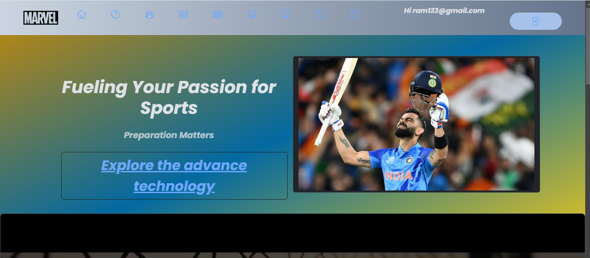
OUTPUT SCREENSHOT:

Slide 23
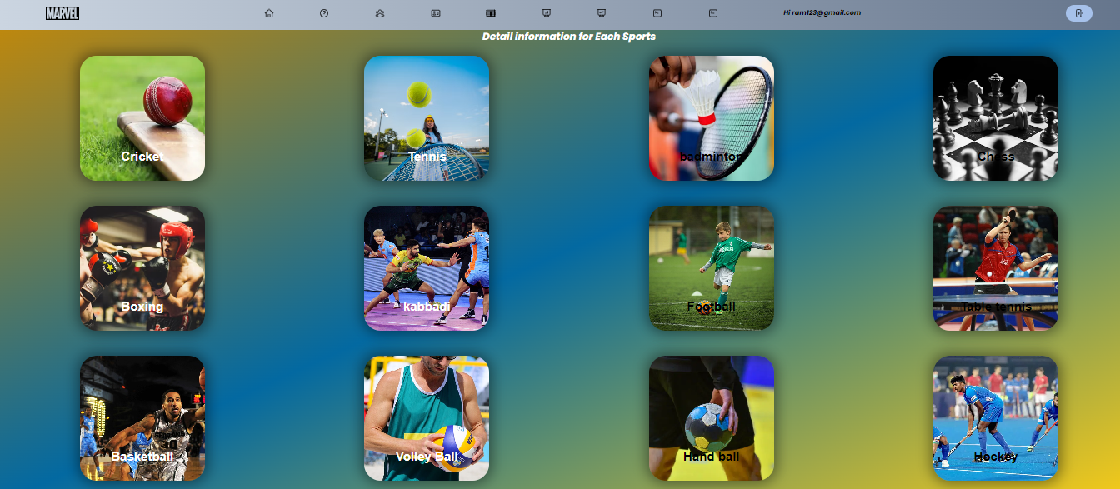
OUTPUT SCREENSHOT:

Slide 24
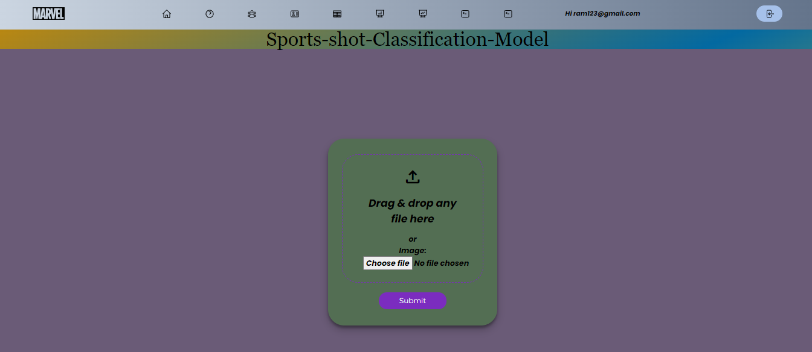
OUTPUT SCREENSHOT:

Slide 25
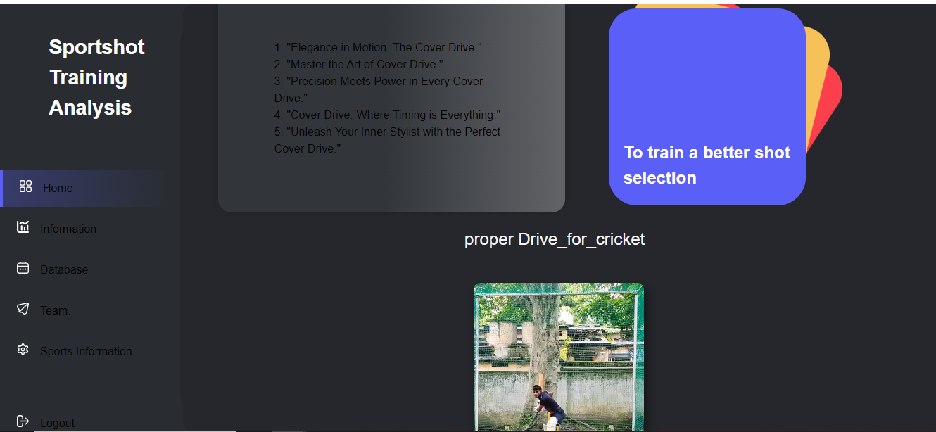
OUTPUT SCREENSHOT:

Slide 26
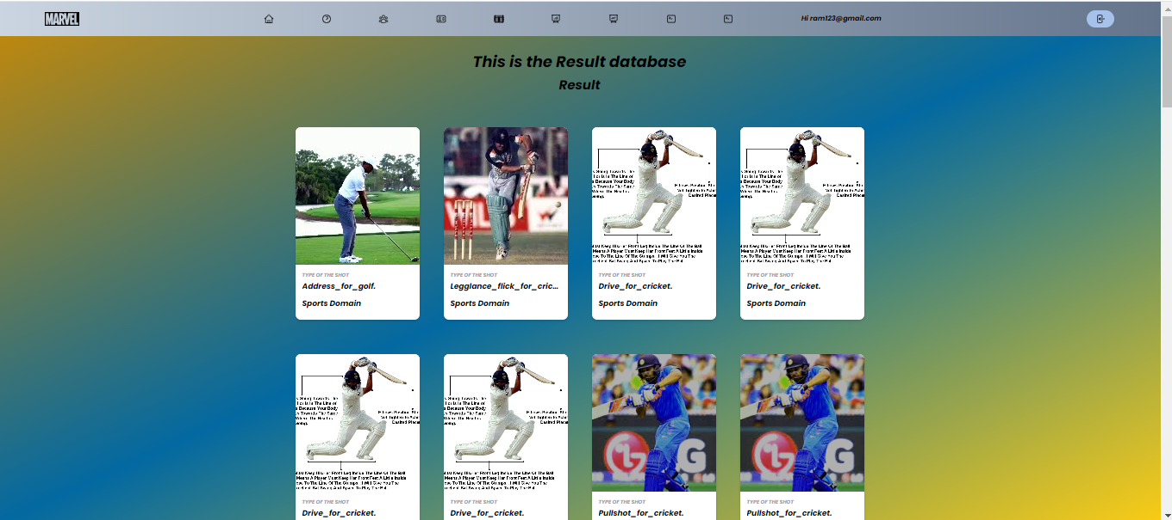
OUTPUT SCREENSHOT:

Slide 27
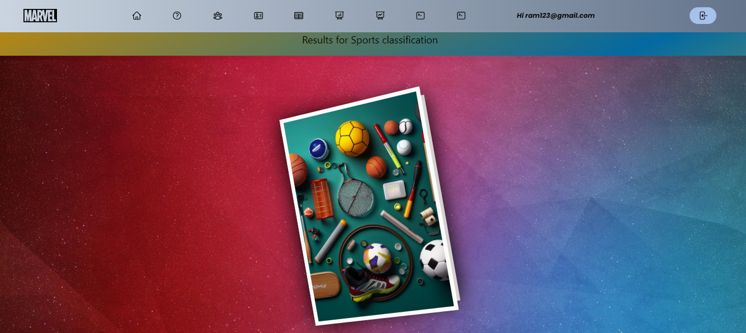
OUTPUT SCREENSHOT:

Slide 28
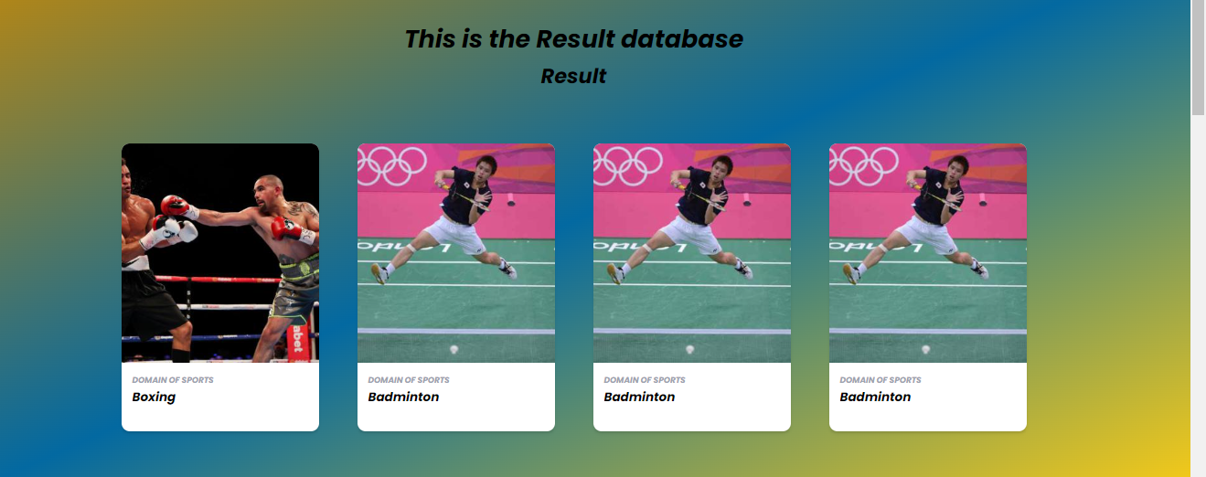
OUTPUT SCREENSHOT:

Slide 29
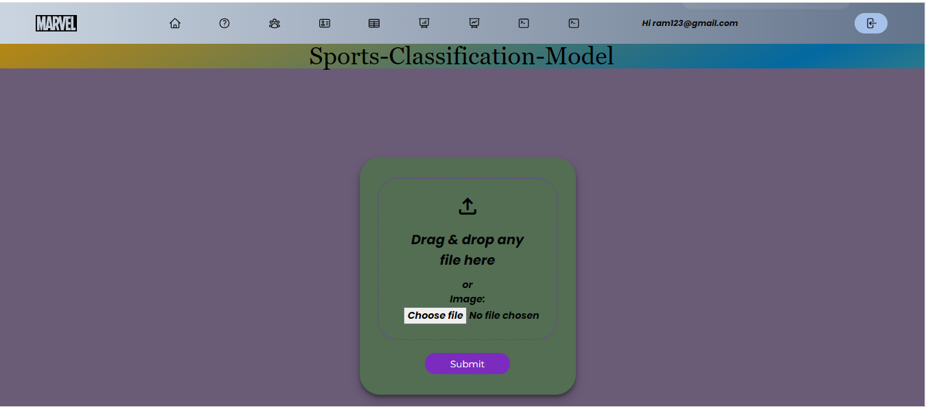
OUTPUT SCREENSHOT:

Slide 30
Conclusion:
In conclusion, the application of deep learning architectures, particularly Convolutional Neural Networks (CNNs), for sports shot classification has demonstrated significant potential in enhancing the accuracy and efficiency of performance analysis in various sports. By leveraging the hierarchical feature extraction capabilities of CNNs, these models can effectively distinguish between different types of shots. The integration of advanced techniques, such as data augmentation and transfer learning, further improves model robustness and generalization across diverse environments and athlete styles. As the field continues to evolve, future research should focus on refining these models and exploring implementation possibilities, ultimately providing coaches and athletes with invaluable insights for performance enhancement and strategic decision-making.

Slide 31
Future work:
Future work in the domain of sport shot classification using deep learning approaches should aim to refine and expand the system's capabilities. Fine-grained classification, delving into subtleties within shot categories, could offer a more nuanced understanding of player techniques and styles. Exploring multi-modal fusion, incorporating audio or player biometrics, may contribute to a richer contextual analysis. Investigating transfer learning and domain adaptation methods could facilitate quicker adaptation to new sports, while real-time feedback mechanisms and continuous learning approaches would ensure the system remains dynamic and responsive. Additionally, the implementation of edge computing could reduce latency, making the model more versatile. Ethical considerations, such as privacy protection through techniques like federated learning, should be addressed. Collaborating with sports analytics platforms and expanding the dataset to include shots from emerging sports would further enhance the system's utility, fostering its continued relevance and applicability in diverse sports scenarios.

